Slide 1
Function
1.It is a block of code that performs a specific task
2.Optionally returns a value to the calling program
3.Every function has a unique name
4.Function is independent and it can perform its task

Slide 2
Function Declarations
return_type function_name( parameter list );
int max(int num1, int num2);
2. Calling a Function
int max(int num1, int num2);
ret = max(a, b);
3.Function definition
int max()

Slide 3
Structure of a Function
<return type> FunctionName (Argument1, Argument2, Argument3……)
{
Statement1;
Statement2;
Statement3;
}
An example of function.
int sum (int x, int y)
{
int result;
result = x + y;
return (result);
}

Slide 4
Types of functions
1. Functions with no arguments and no return values.
2. Functions with arguments and no return values.
3. Functions with arguments and return values.
4. Functions with no arguments and return values.

Slide 5
1.Functions with no arguments and no return values
Without any arguments means cannot pass data to the called function
Program
#include<stdio.h>
void main(void)
{
add();
}
add()
{
int a , b , c ;
c=a+b;
}

Slide 6
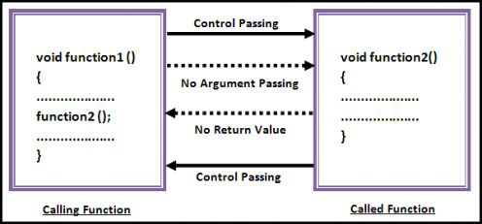

Slide 7
2.Functions with arguments and no return values
Function can accept data from calling function
Program
void main()
{
int a=5;
add(a);
}
add(int b)
{
int c;
c=b+c;
printf(“%d”,c);
}

Slide 8
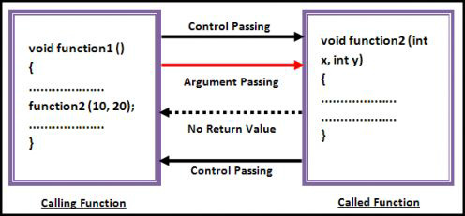

Slide 9
3.Functions with arguments and return values
#include<stdio.h>
Int add(int);
Void main()
{
Int a=10;b=20;
a=a+b;
Add(a);
}
Add(int c)
{
Int d=10;
d=c+d;
Printf(“%d”,d);
return(d);
}

Slide 10
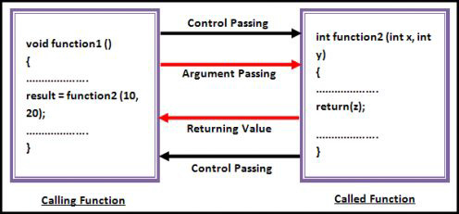

Slide 11
4.Functions with no arguments and return values
Int main(void)
{
add();
}
Int add()
{
Int b;
Return (b);
}

Slide 12
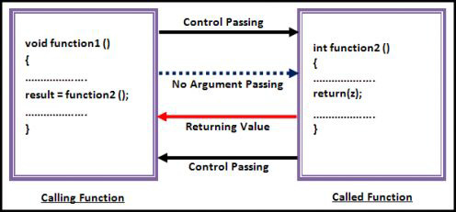

Slide 13
Program
#include<stdio.h>
#include<conio.h>
int send()
{
int no1;
printf("Enter a no : ");
scanf("%d",&no1);
return(no1);
}
void main()
{
int z;
clrscr();
z = send();
printf("\nYou entered : %d.", z);
getch();
}

